Slide 1
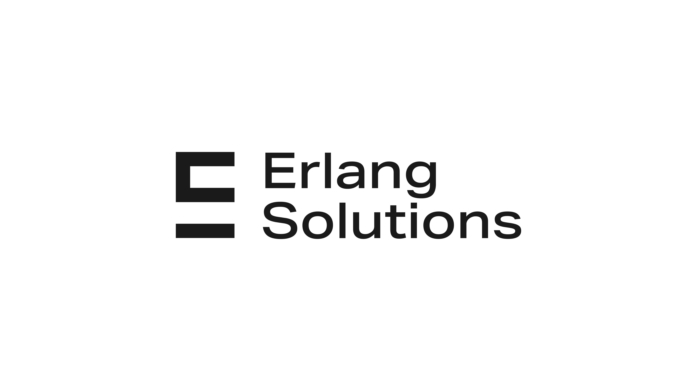

Infrastructure as Code with
Terraform
9/2023

Slide 2
What we have done in last meeting
We know about Infrastructure as Code (IaC)
We know what is Terraform and the reason to use it
We know how Terraform works, Terraform’s workflow
Terraform VS similar technologies
Getting started with Terraform - Demo

Slide 3
For this week, we continue to discover Terraform with the below Agenda
CRUD operations (create, read, update, delete) overview
Example about an AWS Simple Cloud Storage (S3): Plan, Create, No-op, Update, Delete.
Resource Drift
Summary about the Terraform life circle
What’s next?

Slide 4
CRUD Operations

Slide 5
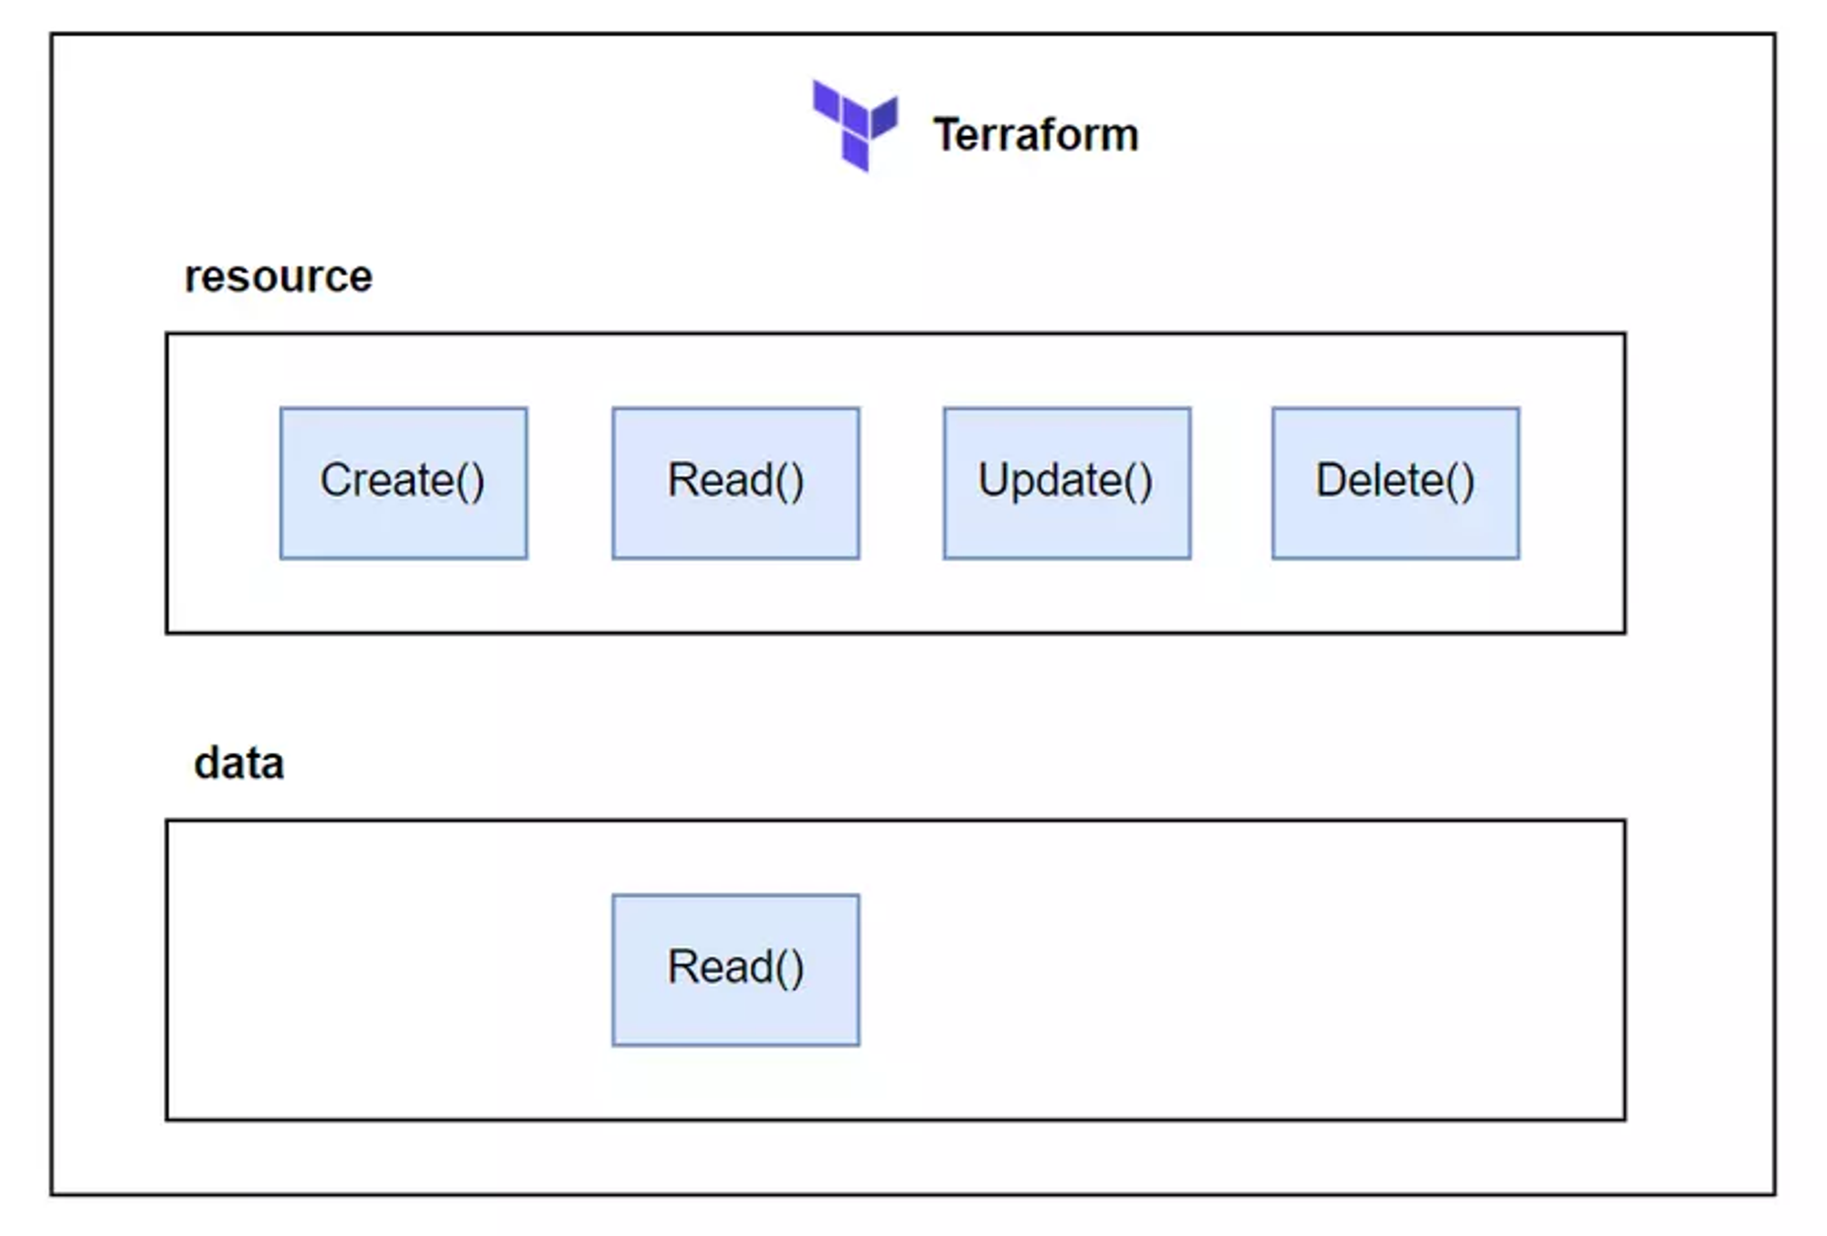
All resource types of Terraform implement a CRUD Interface.
In this CRUD Interface there will be functions like Create(), Read(), Update(), Delete() and these functions will be executed if the right conditions are met.
The two resources in Terraform: a managed resource and an unmanaged data source. The managed resource implements full CRUD, while the data source only implements Read().
Notes:
Fundamentally, Terraform is a state management tool that performs CRUD operations (create, read, update, delete) on managed resources. Often, managed resources are cloud-based resources, but they don’t have to be. Anything that can be represented as CRUD can be managed as a Terraform resource.
Generally speaking, Create() is called during resource creation, Read() during plan generation, Update() during resource updates, and Delete() during deletes.

Slide 6
Let’s do a demo about
AWS simple cloud storage (S3)

Slide 7
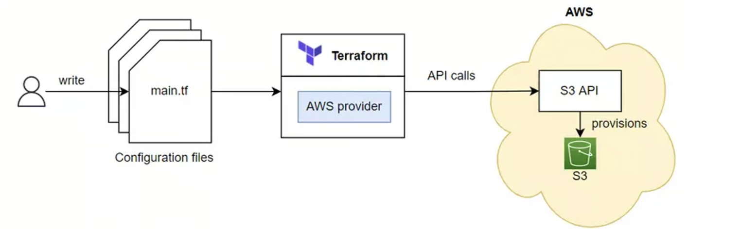
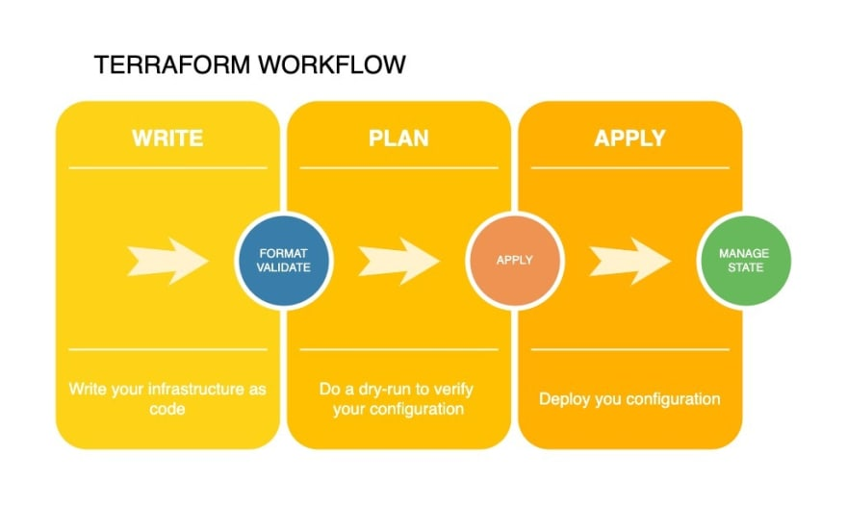
We will use Terraform to create an S3 (AWS Simple Cloud Storage) on AWS to learn about the lifecycle of a resource.
Notes:
First, we’ll create the resource. Next, we’ll simulate configuration drift and perform an update. Finally, we’ll clean up with terraform destroy. The procedure is shown here.

Slide 8
Declaring the configuration file
Now we will write the Terraform file to create S3 and talk about each of the above functions. Create a Wordspace named S3, then create a file named main.tf with the following code:
provider "aws" {
region = "us-west-2"
}
resource "aws_s3_bucket" "terraform-bucket" {
bucket = "terraform-series-bucket-bao"
tags = {
Name = "Terraform Series"
}
}
Notes:
Let’s get started by creating a new workspace for Terraform. Do this by creating a new empty directory somewhere on your computer. Make sure the folder doesn’t contain any existing configuration code, because Terraform concatenates all .tf files together. In this workspace, make a new file called main.tf and add the following code.
In the above file we use the resource aws_s3_bucket, this is the resource used to create S3 Bucket on AWS Cloud, in which the bucket field will be our Bucket name. After finishing writing, we run the init command to let Terraform download the Provider to the current Workspace.
Explanation for aws_s3_bucket
A bucket is a container for objects stored in Amazon S3. You can store any number of objects in a bucket and can have up to 100 buckets in your account.
AWS S3 is a key-value store, one of the major categories of NoSQL databases used for accumulating voluminous, mutating, unstructured, or semistructured data.
https://registry.terraform.io/providers/hashicorp/aws/latest/docs/data-sources/s3_bucket

Slide 9
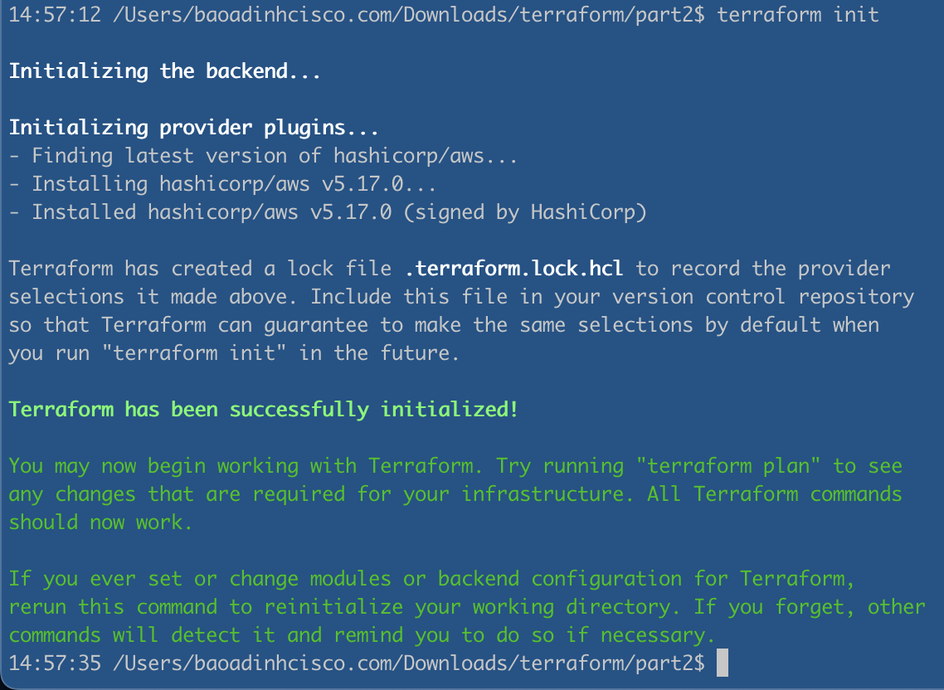
Initializing the workspace
Notes:
Terraform configuration must always be initialized at least once, but you may have to initialize again if you add new providers or modules.
You can call it as many times as you want in a row with no side effects.

Slide 10
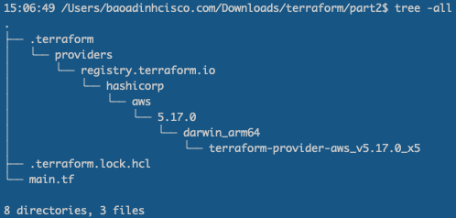
After initialization, Terraform creates a hidden .terraform directory for installing plugins and modules.
The directory structure for the current Terraform workspace is the following:

Slide 11
Read() operation

Slide 12
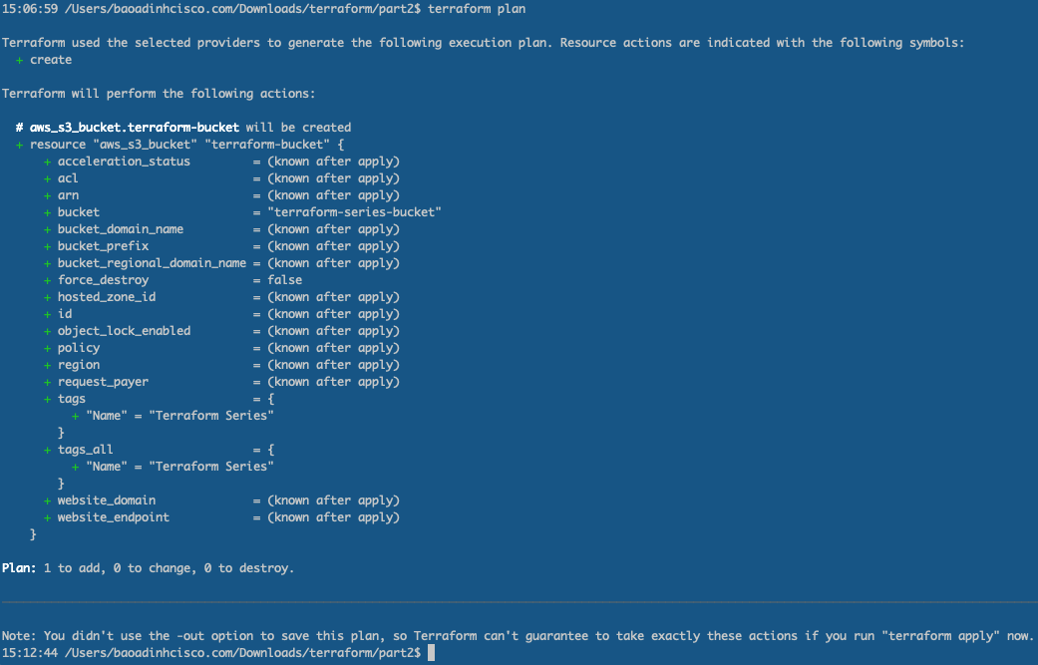
Check which resources will be created
Notes:
After initializing the Workspace, before we create the actual resource, we need to check which resources will be created. This step is not required. But to be careful, when doing this, we just run through this step, to check what the resource will look like before we create it on our real infrastructure. To check resources, we run the terraform plan command.
When you run the plan command, Terraform will show you which resources will be created. In the line displayed near the end you will see Plan: 1 to add, 0 to change, 0 to destroy., meaning there will be A resource is added to our current infrastructure. In addition to displaying the resources that will be created, this command will also check for syntax errors in the Terraform configuration file and will report an error if the syntax is not correct.

Slide 13
If you need to save the results of the plan statement, you use the -out attribute at runtime.
For example, we will save the results of the plan statement in a JSON file.
terraform plan -out plan.out
terraform show -json plan.out > plan.json

Slide 14
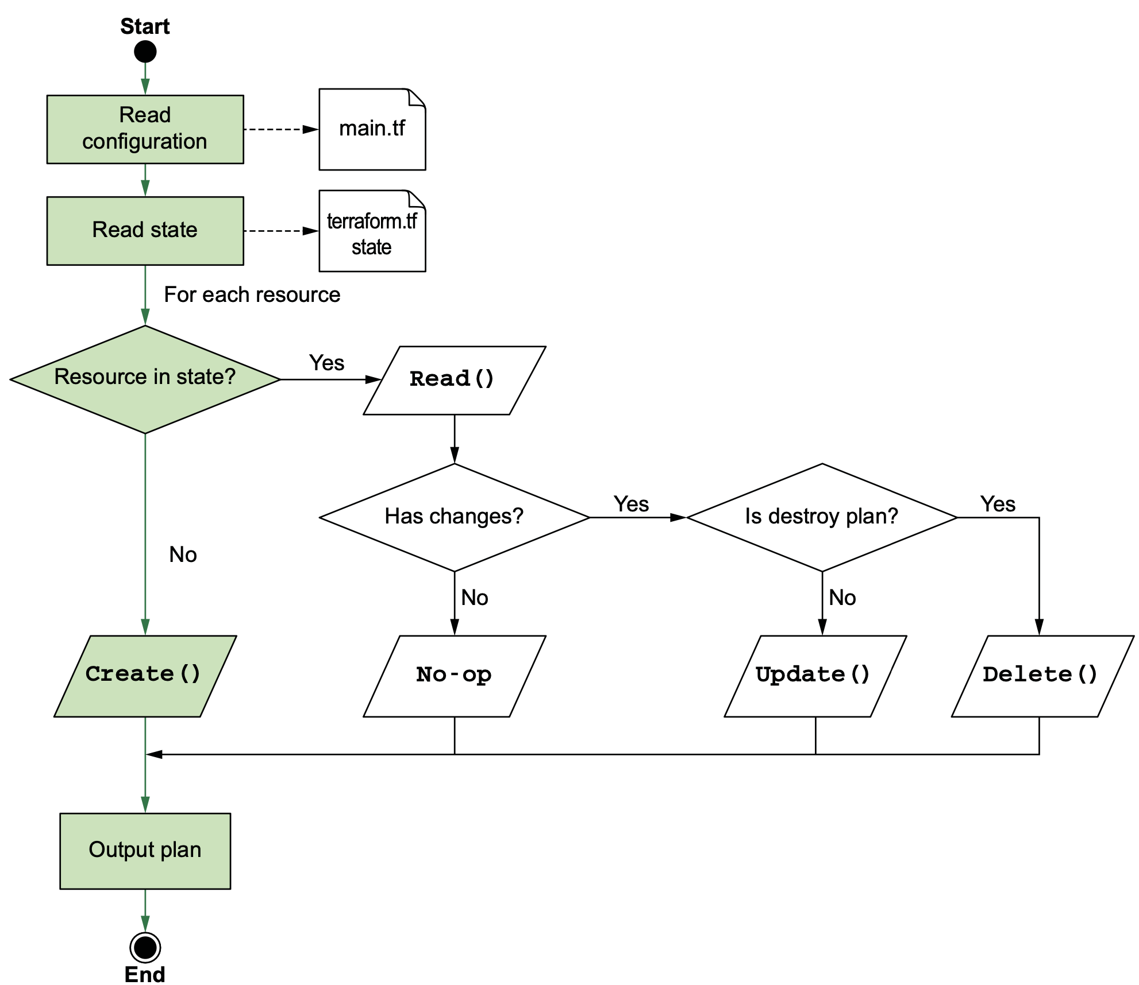
IIlustrative diagram of the plan process
Notes:
The plan process will print out very useful results for us. Just read what the plan process prints and we will know what the resources on our infrastructure will look like.
When we run the plan command, Terraform will perform 3 main steps as follows
- Read configuration file and State file - Terraform will read your configuration file and State file (if exists) first to get information about the resource
It will then determine what actions will be performed - Terraform will perform calculations to determine which actions will be executed, which can be Create(), Read(), Update(), Delete() , or do nothing (No-op)
Output

Slide 15
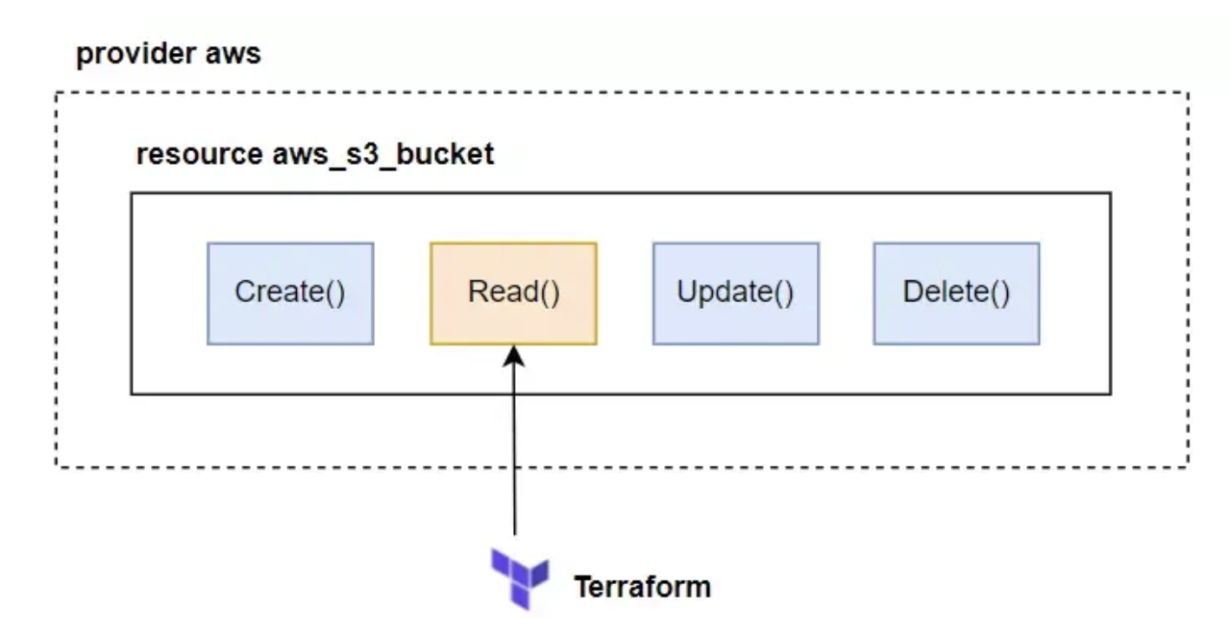
When terraform plan is run, Terraform call Read()on each resource in the state file.
Notes:
Since our state file has only one resource, Terraform calls Read() on just aws_s3_bucket

Slide 16
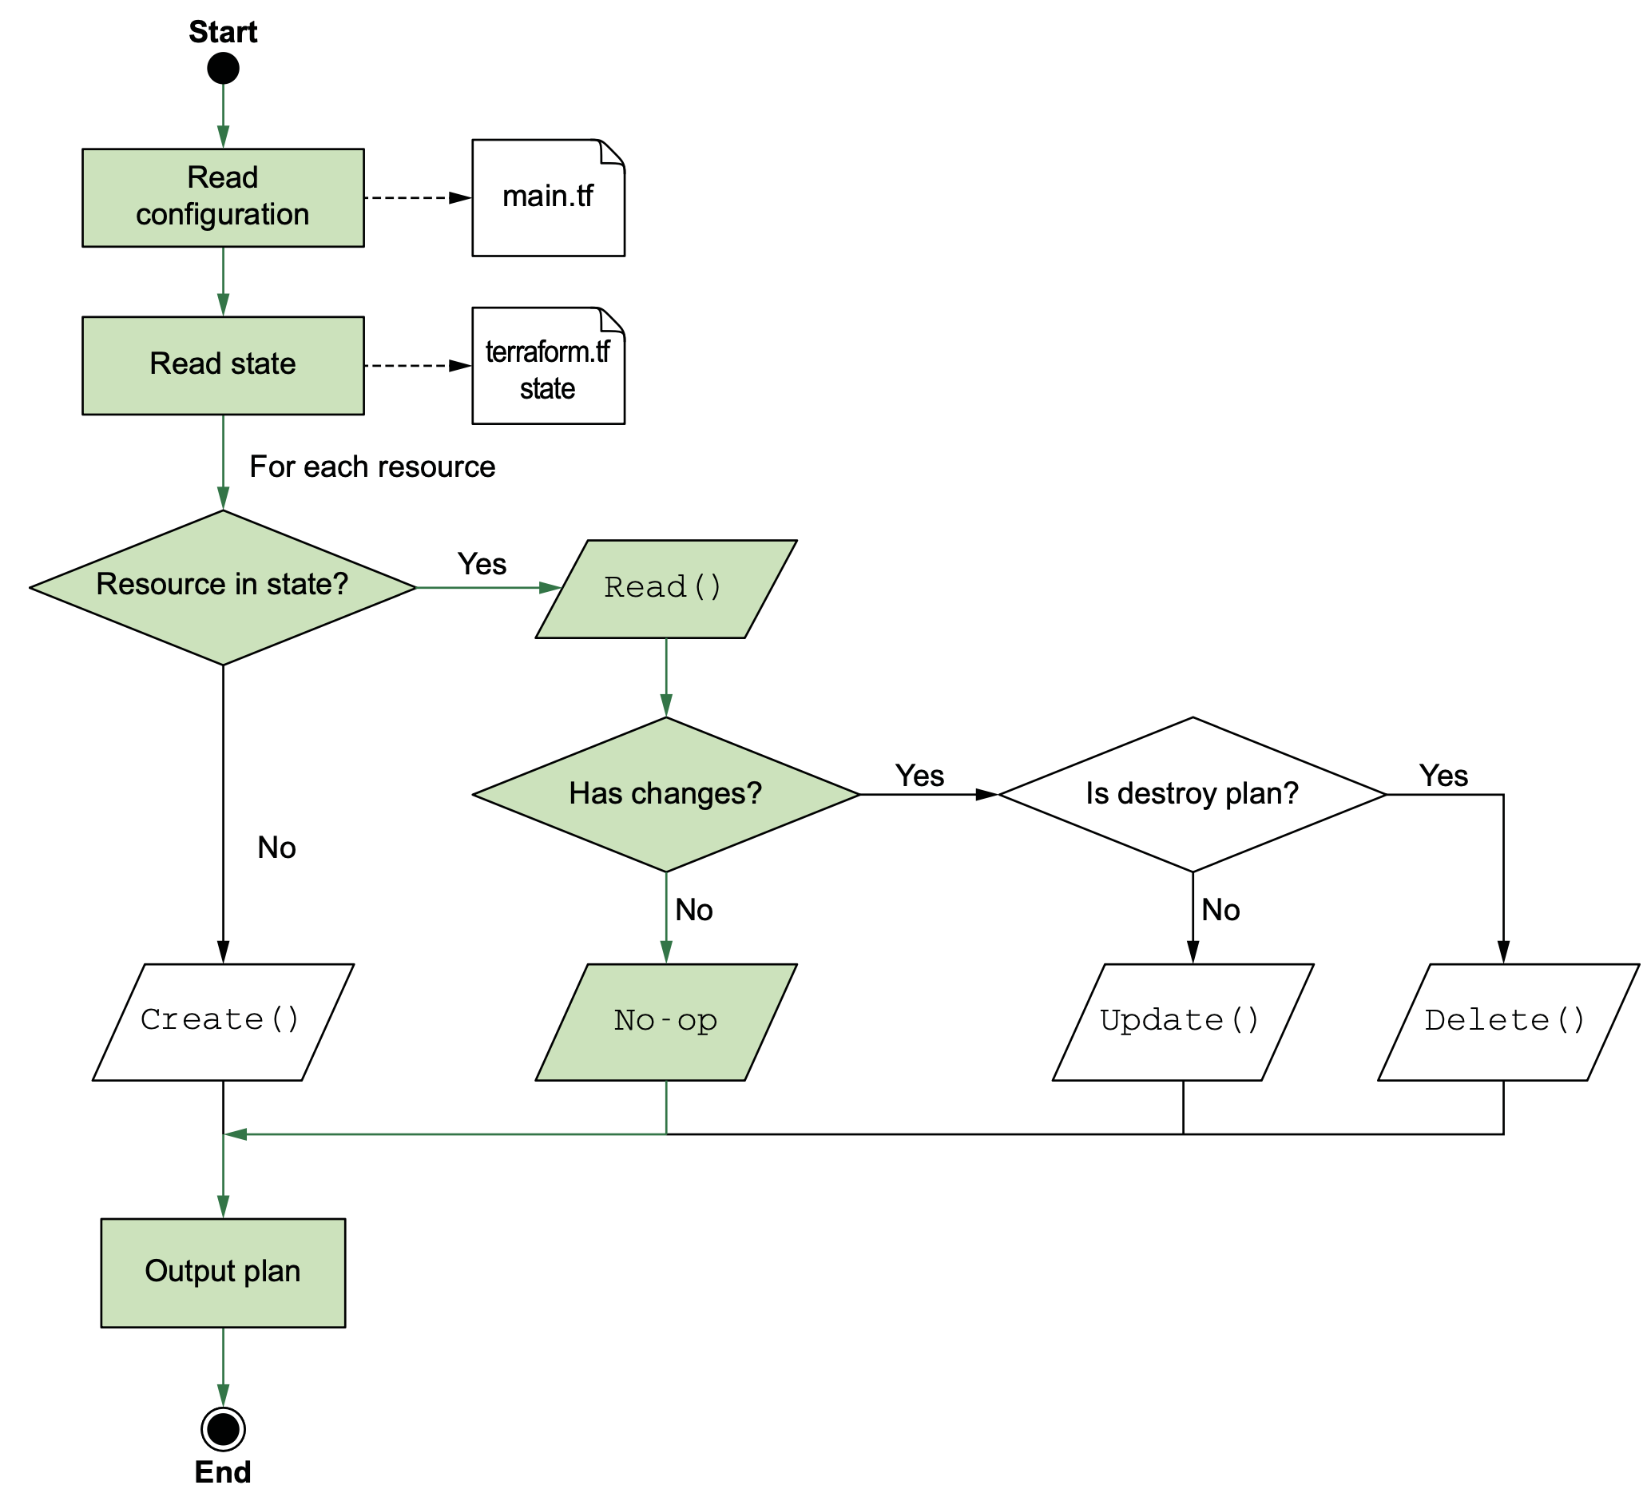
If there are no changes when running terraform plan, the resulting action is a no-operation (no-op).
Notes:
Read() operation call the API to AWS and read information of the current S3 Bucket, then it will compare with S3 in the State file. If nothing has changed, the Read() function will return the result that nothing has changed, and terraform will not perform any action.

Slide 17
Create() operation

Slide 18
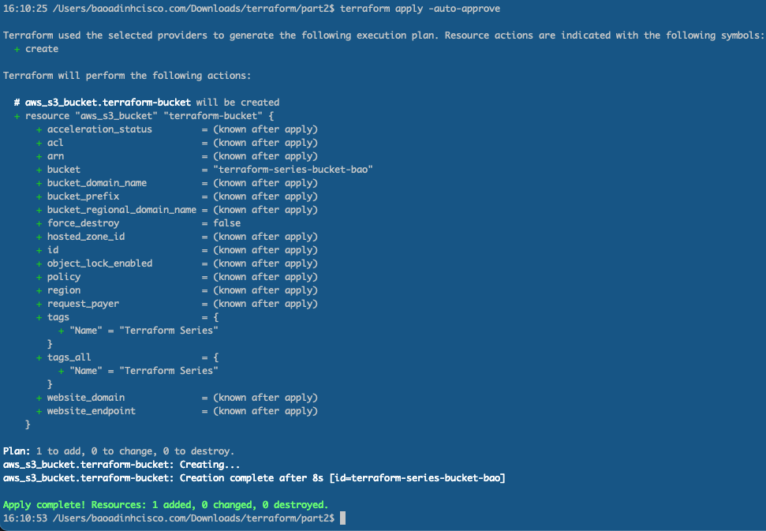
Initializing the workspace
Now we will run the apply command to create S3 on AWS. When we run the apply command,
it will have an additional confirmation step and require us to enter yes.
If you want to skip the confirmation step, then when running, add the attribute -auto-approve.
Notes:
Terraform configuration must always be initialized at least once, but you may have to initialize again if you add new providers or modules.
You can call it as many times as you want in a row with no side effects.

Slide 19
When finished running, you will see a new file created terraform.tfstate
The terraform.tfstate file you see here is the state file that Terraform uses
to keep track of the resources it manages. It’s used to perform diffs during the plan
and detect configuration drift. Here’s what the current state file looks like.
<Open and check the new file in terminal>
<Open AWS and check that S3 is created after running apply>

Slide 20
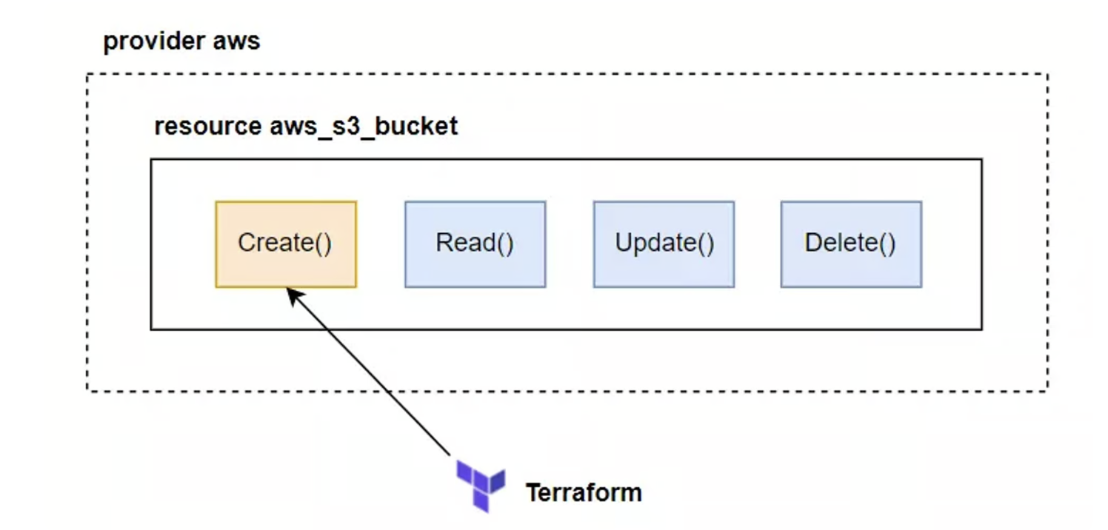
During the apply process, Terraform will call the Create() function of the aws_s3_bucket resource.
Notes:
How did Terraform create this S3 Bucket?
During the apply process, Terraform will call the Create() function of the aws_s3_bucket resource.

Slide 21
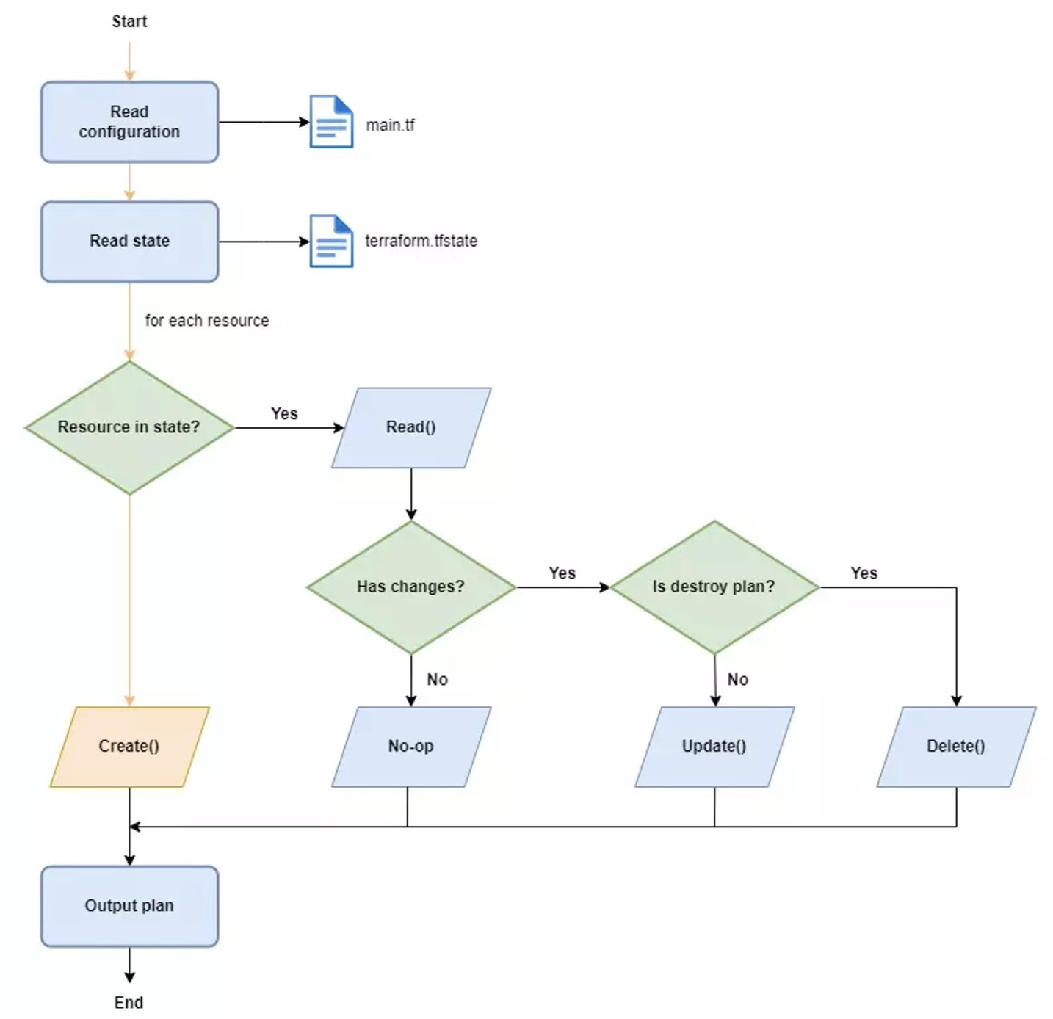
The Create()function contains code to call the API to AWS to create an S3 Bucket.
When Terraform calls this function, the S3 Bucket will be created, illustrated as this figure.

Slide 22
Update() operation

Slide 23
In Terraform there is no update command, we just need to edit the configuration file
and run the apply command again, Terraform will automatically determine
whether to update the resource or not. We changed the name of the S3 Bucket.
provider "aws" {
region = "us-west-2"
}
resource "aws_s3_bucket" "terraform-bucket" {
bucket = "terraform-series-bucket-rabbitmq"
tags = {
Name = "Terraform Series"
}
}
Notes:
There isn’t a special command for performing an update; all that needs to happen is a terraform apply. Before we do that, though, let’s run terraform plan to see what the generated execution plan looks like.
We will see what is the command output in the next slide …

Slide 24
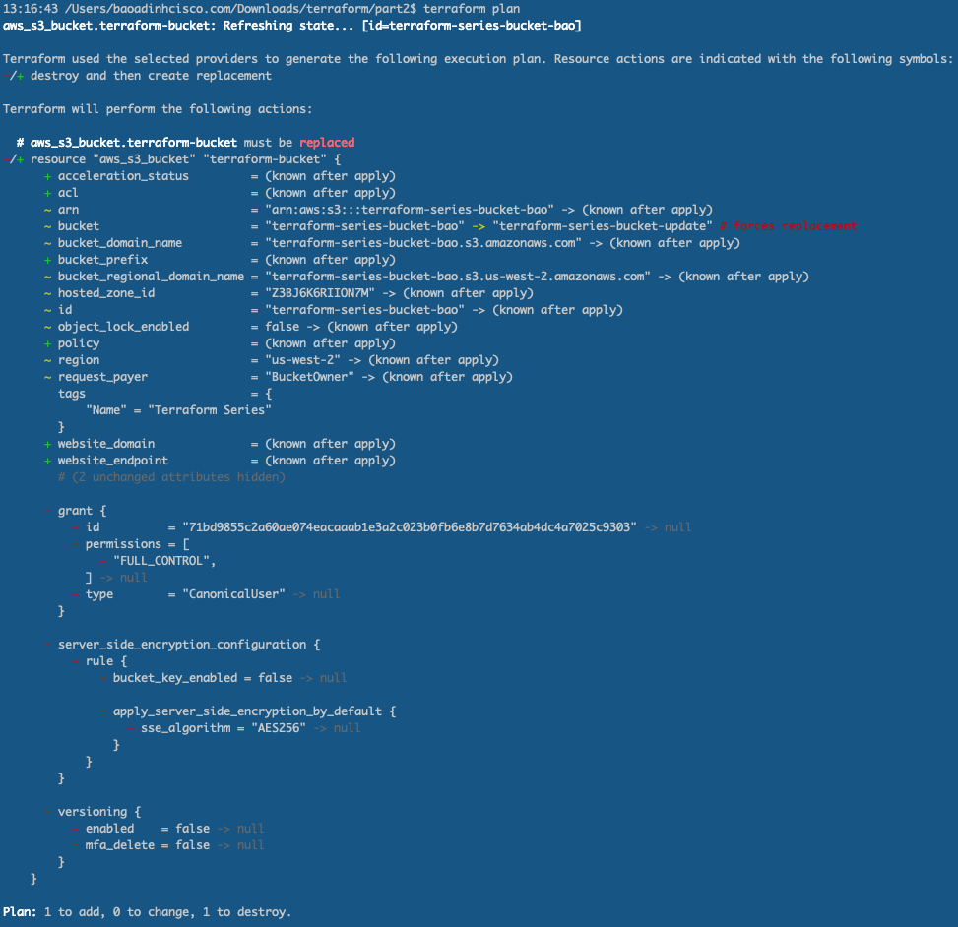
Reviewing the changes by running terraform plan
Notes:
As you can see, Terraform noticed that we changed the content attribute. So, instead of just changing it, Terraform wants to get rid of the old thing and make a completely new one. This happens because the content attribute is special – if you change it, the whole thing gets messed up. So, to get the new thing we want, Terraform has to start from the beginning and create it all over again. This is a good example of something called "immutable infrastructure," where things can't be changed once they're set up. But not everything in Terraform works this way. In fact, most things can be changed without starting over. The difference between these two ways is shown in next slide

Slide 25
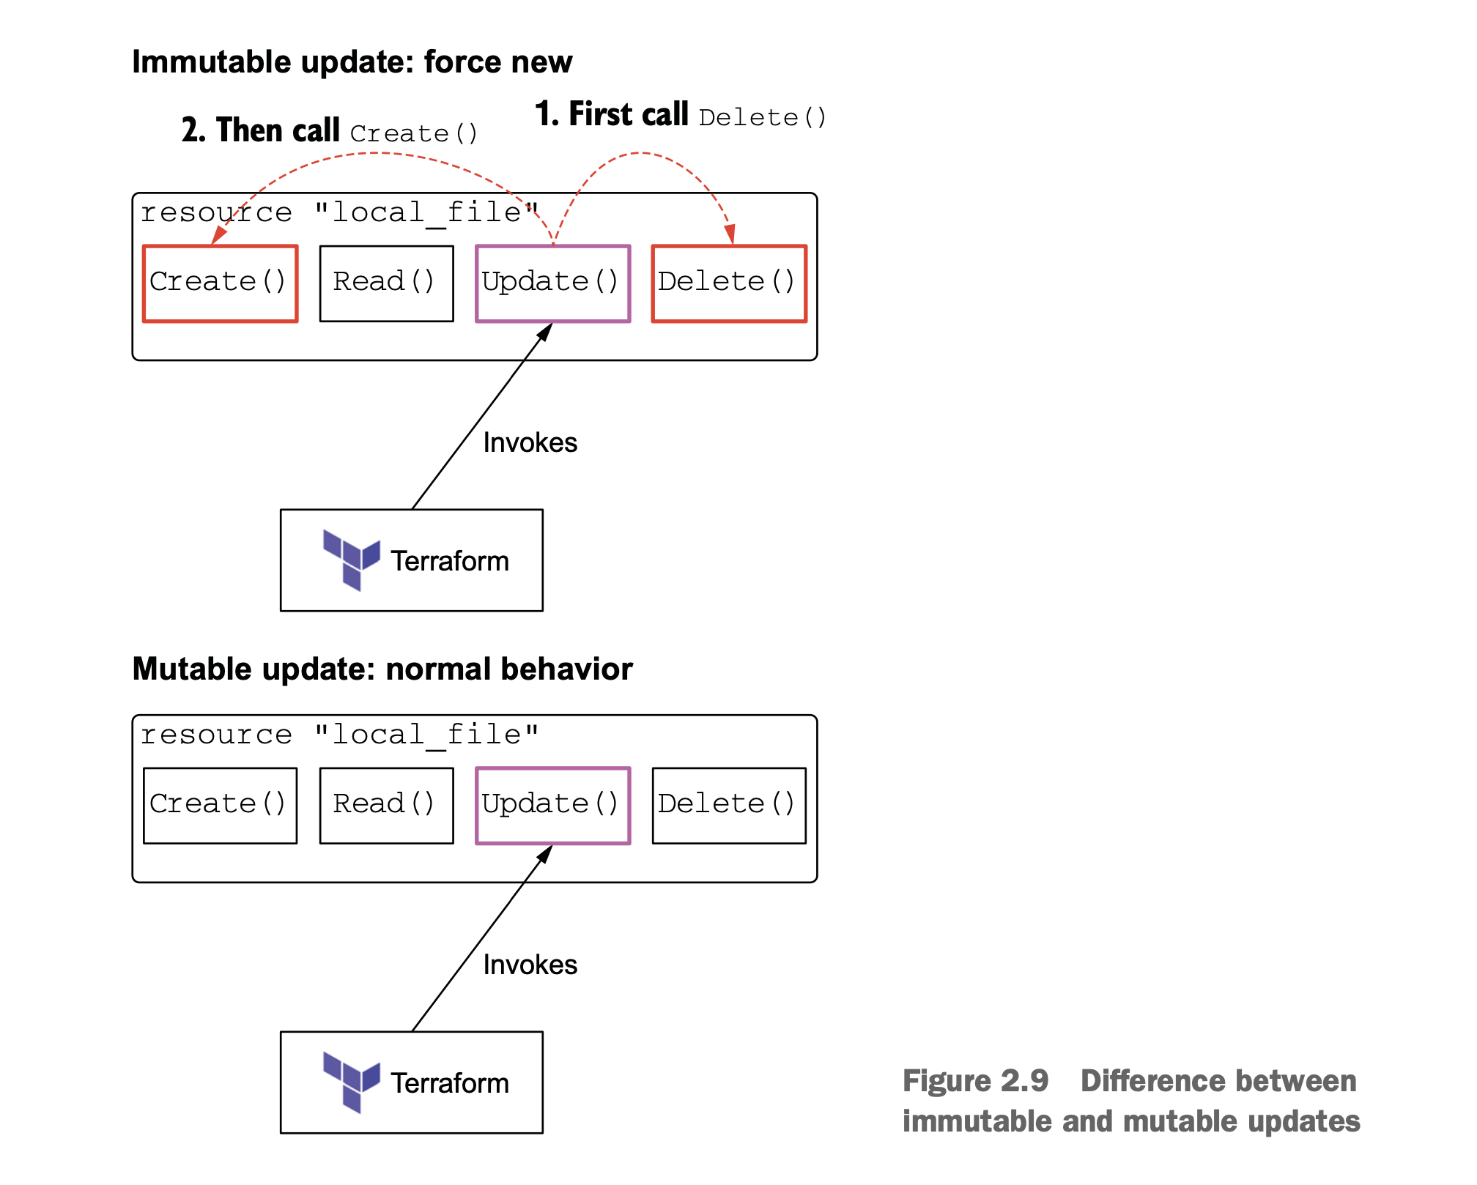

Notes:
In Terraform, resources will have two types of properties: Force New and Normal Update:
- Force new: the resource will be deleted and recreated, delete the previous old resource and recreate the new resource
Normal Update: resources are updated normally, no need to delete old resources

Slide 26
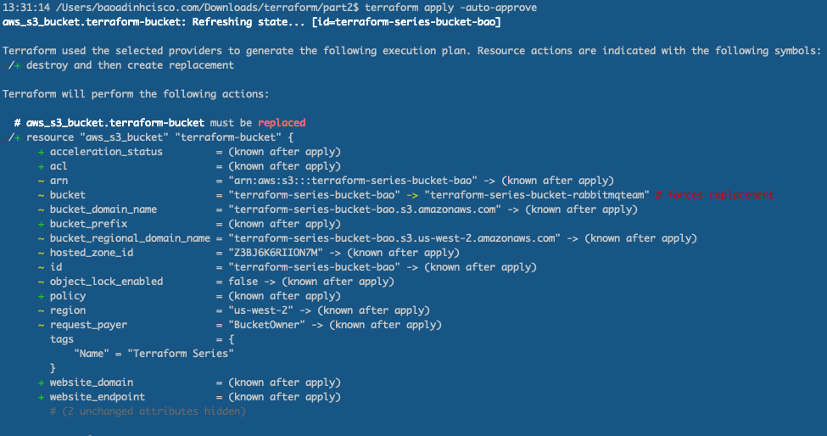
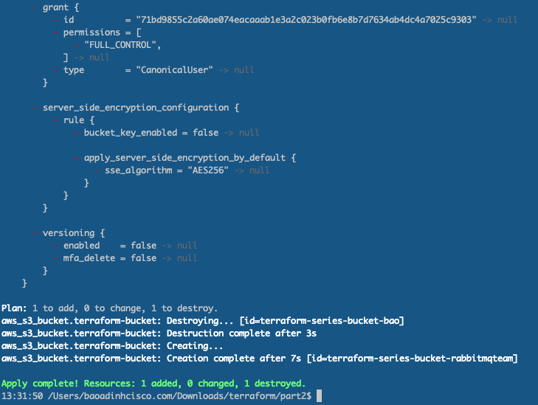
Because our S3 Bucket was just created and there is nothing in it,
we just run terraform apply so it updates normally.
1
2
S3 Bucket with new name updated:

Slide 27
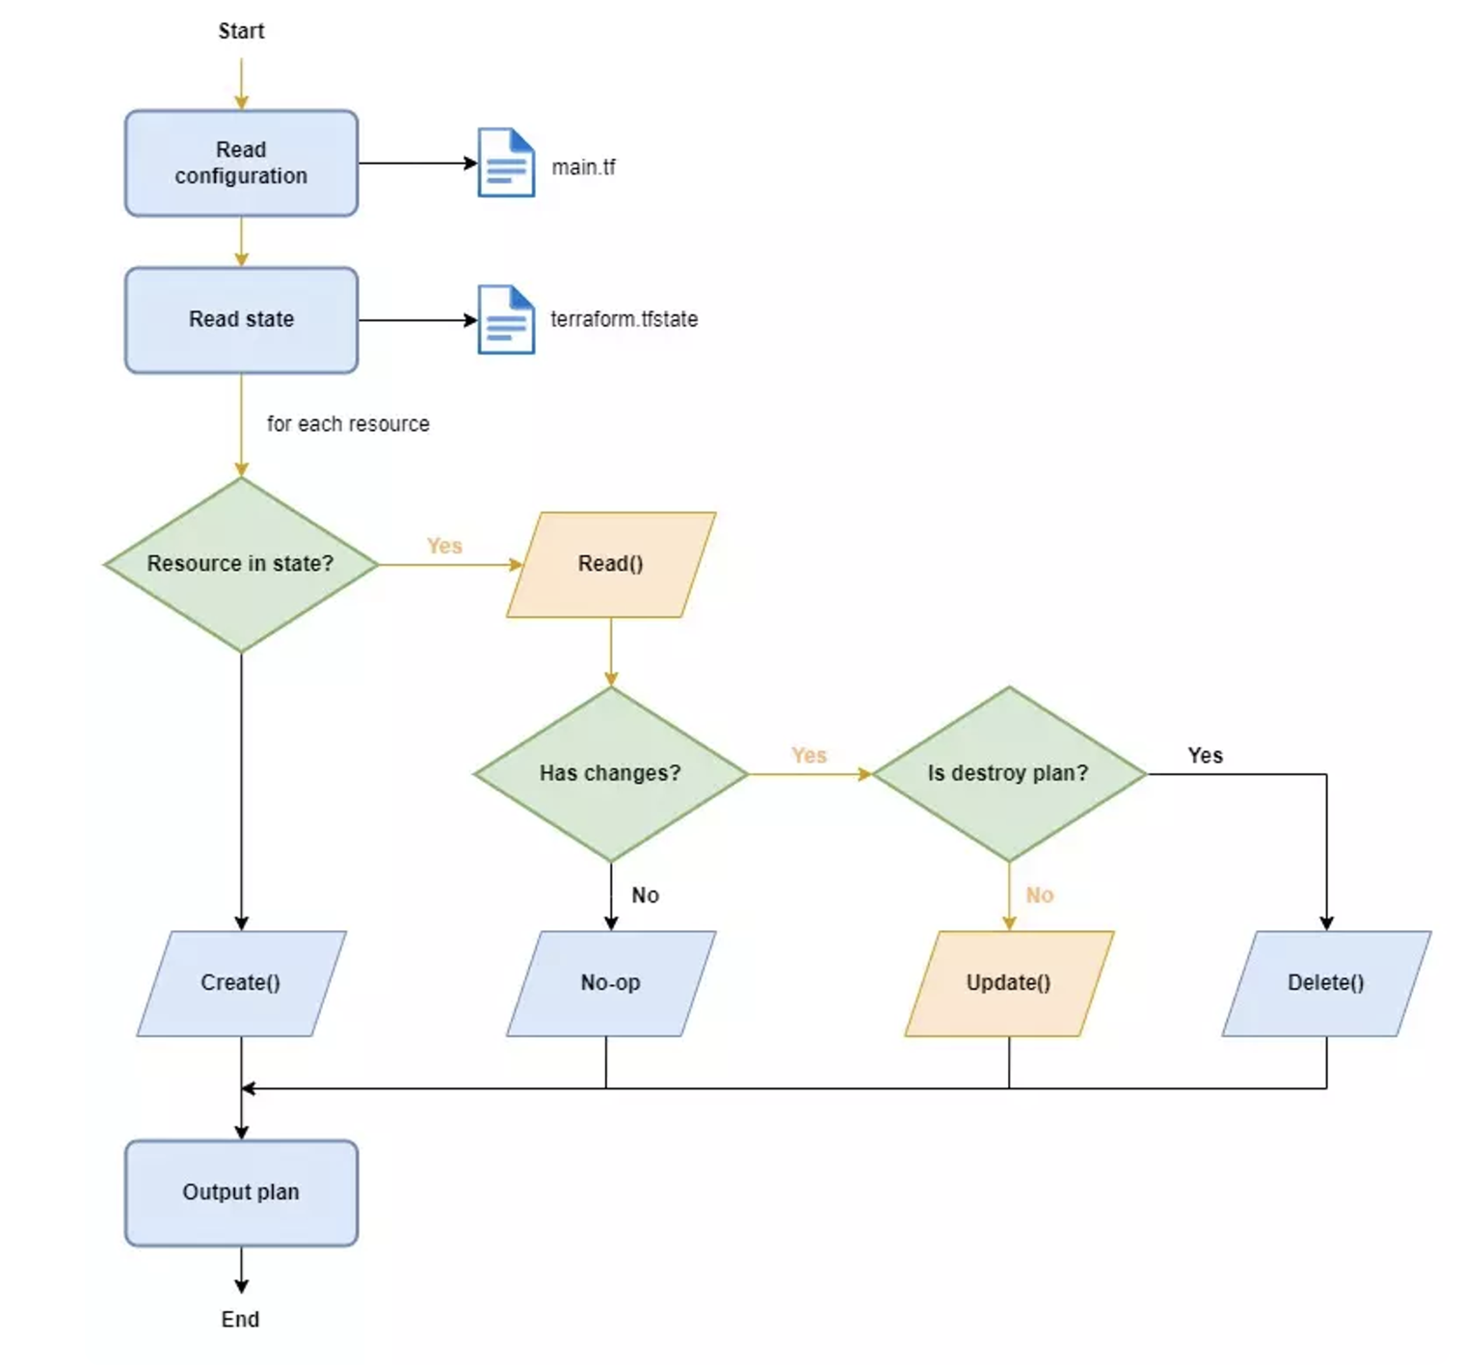
Illustrative diagram of the update process

Slide 28
Delete() operation
Notes:
Our S3 has served us well, but now it’s time to say goodbye. Let’s clean up by running terraform destroy:

Slide 29
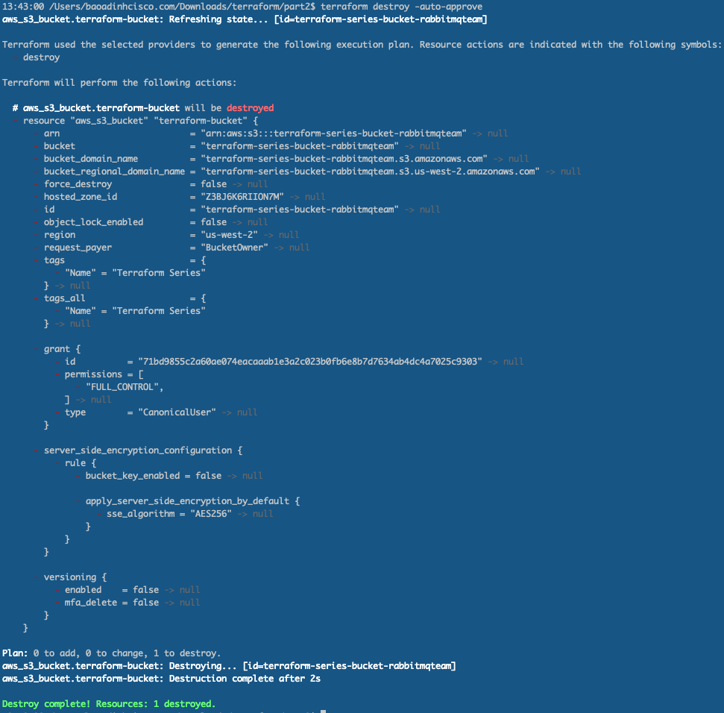
Let’s clean up by running terraform destroy

Slide 30
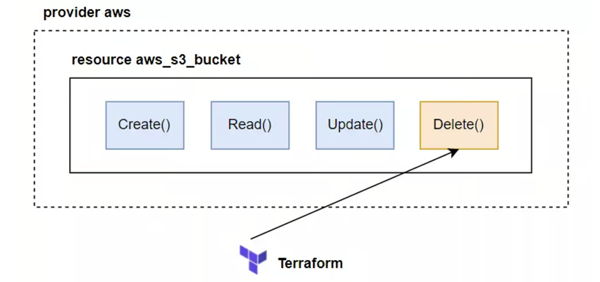
When we run the destroy statement, it will read in our State file to see if there is that resource.
If so, it will execute the Delete() function of the aws_s3_bucket resource.
Notes:
The terraform destroy command first generates an execution plan as if there were no resources in the configuration files by performing a Read() on each resource and marking all existing resources for deletion.

Slide 31
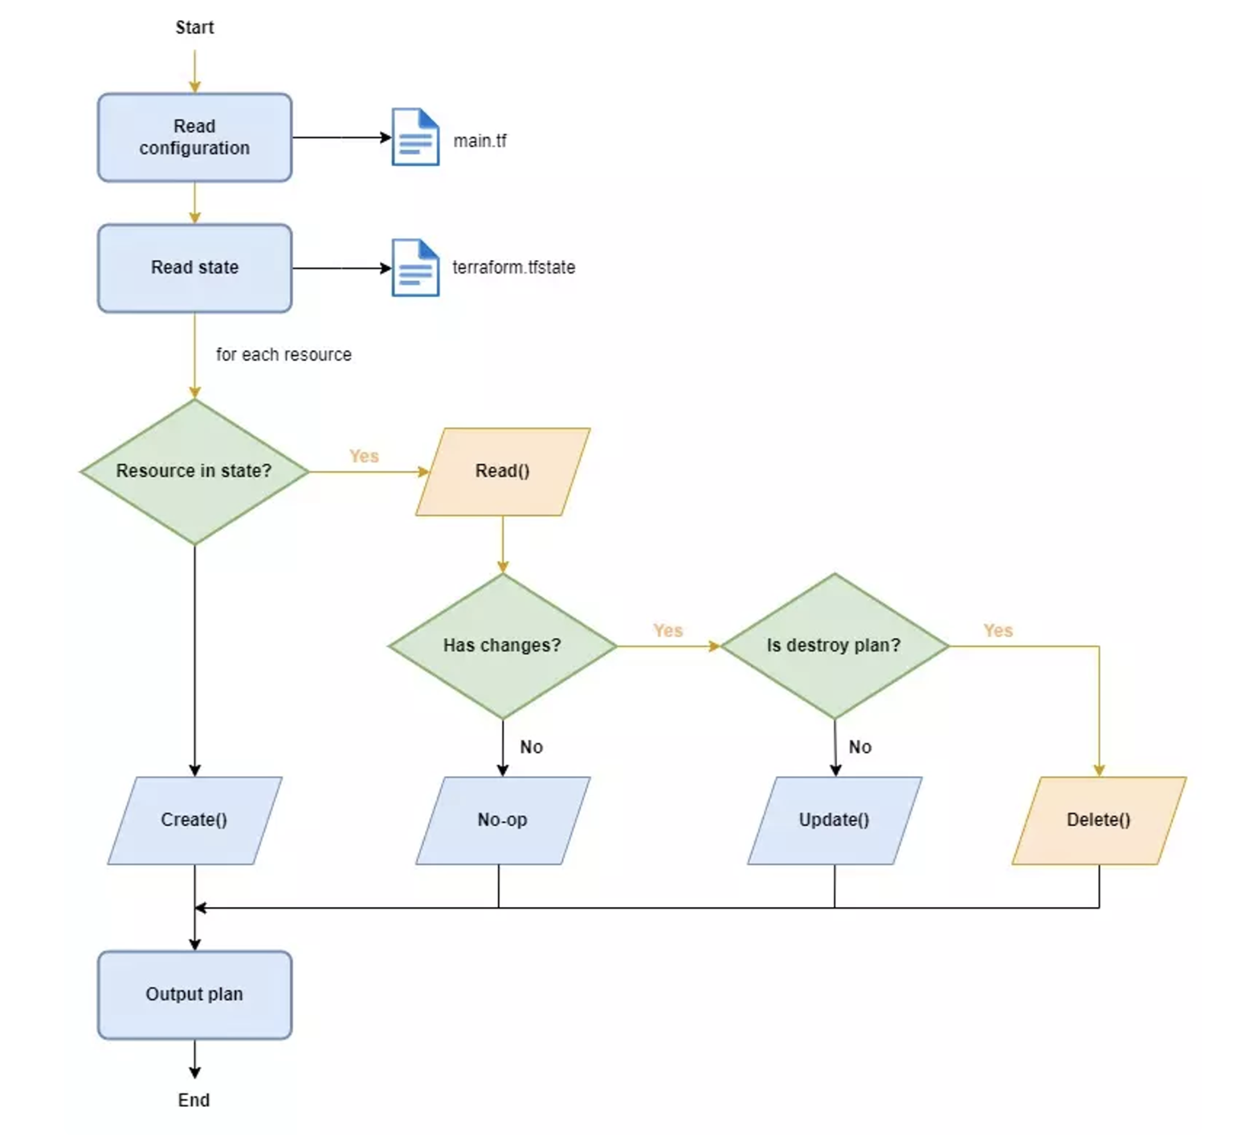
Illustrative diagram of the delete process

Slide 32
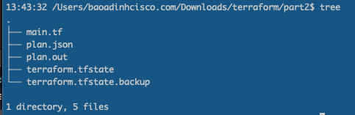
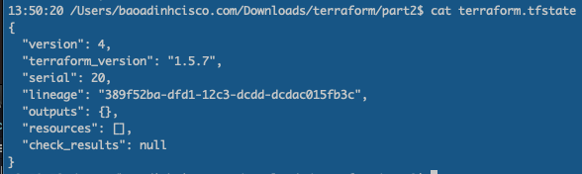
Although it’s gone, its memory lives on in a new file, terraform.tfstate.backup
And our current state file is empty
Notes:
This backup file is a copy of the previous state file and is there for purely archival purposes. This file typically is not needed and can be safely deleted if you wish. Our current state file is empty.
Check the AWS to see the instance was deleted

Slide 33
Resource Drift

Slide 34
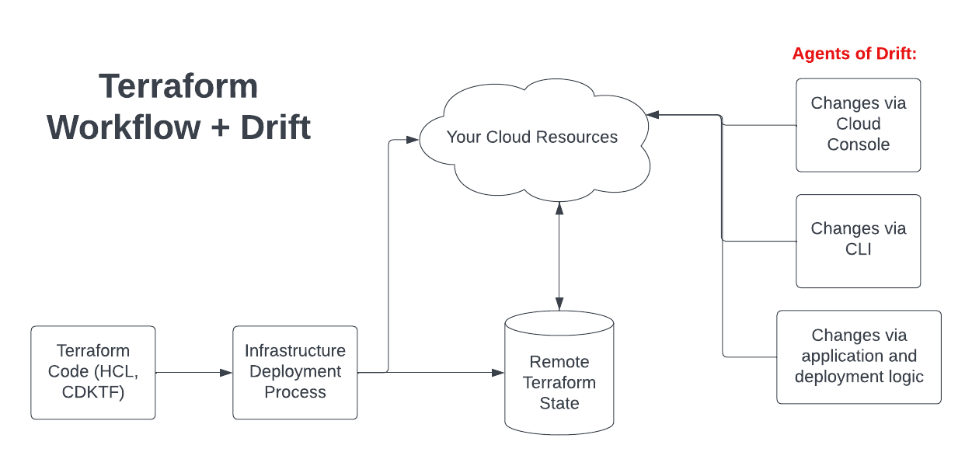
Any change – not triggered by Terraform – that occurs to the infrastructure being managed
by Terraform is known as a drift
Notes:
Until now, we've been able to create new bucket and update the bucket name using Terraform. But what if someone makes changes directly to the file without using Terraform? This is called "configuration drift." It happens a lot when many people with special permissions use the same file system. If you have resources in the cloud, it's like someone making changes directly in the online console. So, how does Terraform handle this configuration drift? It figures out what's different between how things are now and how we want them to be. Then, it makes the necessary updates to get everything back in line with what we want.
Resource Drift is a problem when the configuration of our resource is changed outside of Terraform.
With AWS, it could be because someone uses the Web Console | CLI | application to change the configuration
of a resource that we created with Terraform.

Slide 35
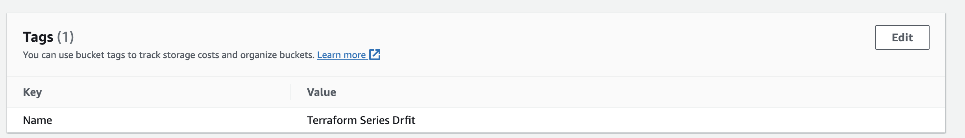
We will re-use the main.tf file above, apply it to create the S3 on AWS
provider "aws" {
region = "us-west-2"
}
resource "aws_s3_bucket" "terraform-bucket" {
bucket = "terraform-series-bucket-rabbitmq"
tags = {
Name = "Terraform Series"
}
}
Then, we come to AWS Web Console and edit the Tags field
Notes:
Terraform will not automatically detect and update our Terraform file, it is not that magical 😂. When we run the apply command, it will detect the change and update the tags field that we changed outside of Terraform to be the same as the tags we wrote in the configuration file. You run the plan command first to see.

Slide 36
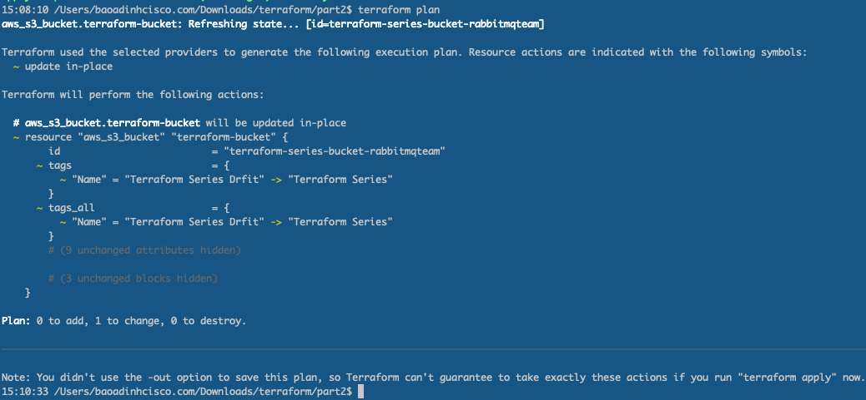
Run terraform plan to see what Terraform has to say for itself:
Notes:
Wait, what just happened? Terraform appears to have forgotten that the resource it manages even exists and is therefore proposing to create a new resource. In fact, Terraform has not forgotten that the resource it manages exists—the resource is still present in the state file, and you can verify by running terraform show:

Slide 37
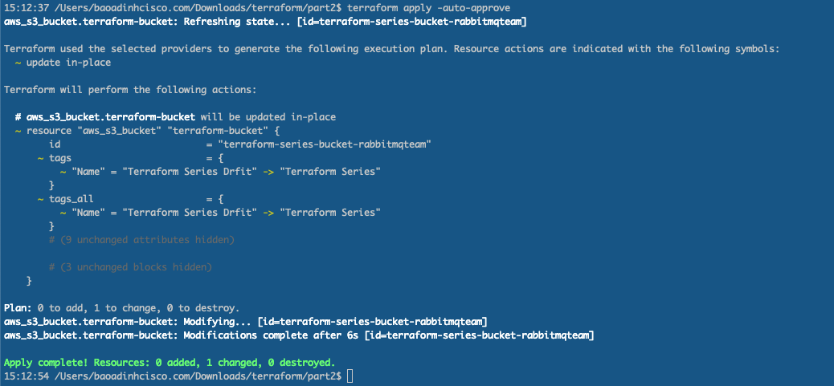
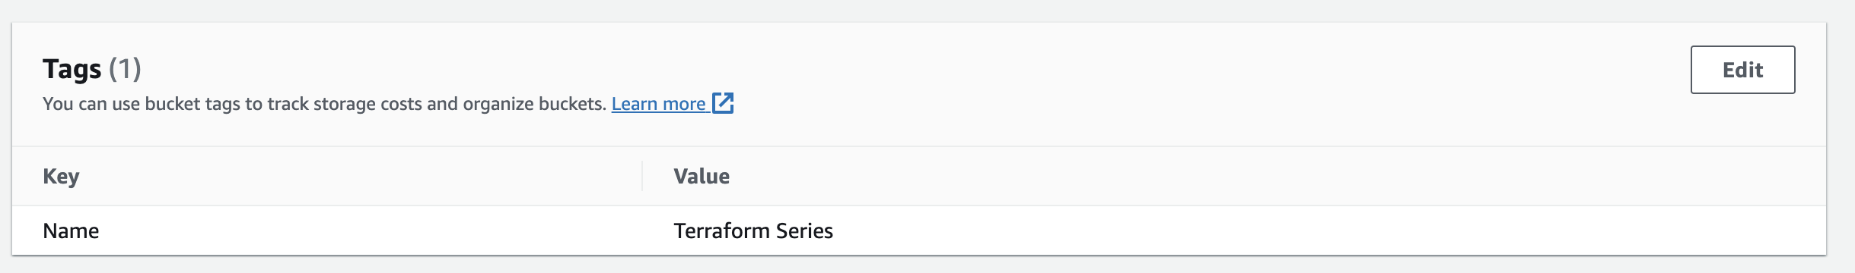
Rerun the apply command and we will see that the tags will be updated as before.

Slide 38

Identifying Drifts
Notes:
When infrastructure drift happens, the first challenge is to notice those drifts. there are multiple sources of drift. Thus it is not possible to track from where and when the drifts happen unless we have some monitoring in place.

Slide 39
The terraform refresh command helps refresh the state file, and the plan
command provides a plan of action by analyzing the state file and current configuration.
The output provided by the plan command helps us identify drifts.
Running refresh does not modify infrastructure, but does modify the state file.
If the state has drifted from the last time Terraform ran, refresh allows that drift to be detected
Notes:
Without changing the Terraform config, if the execution of a plan command suggests either modifying or recreating a certain resource – then this indicates that something else has modified the infrastructure. But this depends on the moment when we choose to run these commands. It often happens when we prepare and check the status before implementing other intended changes.
Terraform Refresh: It does this by querying your infrastructure providers to find out what's actually running and the current configuration, and updating the state file with this new information.

Slide 40
The lifecycle of a resource in Terraform

Slide 41
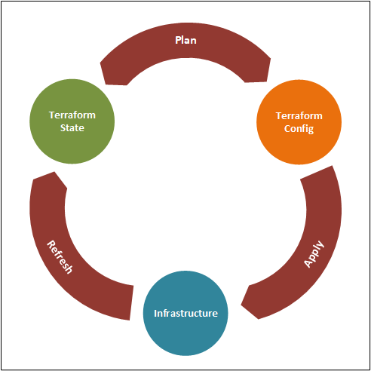
Notes:
Each managed resource has life cycle function hooks associated with it: Create(), Read(), Update(), and Delete(). Terraform invokes these function hooks as part of its normal operations.
○ Changing Terraform configuration code and running terraform apply will update an existing managed resource. You can also use terraform refresh to update the state file based on what is currently deployed.
○ Terraform reads the state file during a plan to decide what actions to take during an apply. It’s important not to lose the state file, or Terraform will lose track of all the resources it’s managing

Slide 42
Summary
Each managed resource has life cycle function hooks associated with it:
Create(), Read(), Update(), and Delete().
Terraform invokes these function hooks as part of its normal operations.
Changing Terraform configuration code and running terraform apply
will update an existing managed resource. You can also use terraform refresh
to update the state file based on what is currently deployed.
Terraform reads the state file during a plan to decide what actions to take during an apply.
It’s important not to lose the state file, or Terraform will lose track of all the resources it’s managing

Slide 43


Slide 44
Chapter 3 is our first look at variables and functions

Slide 45

Q&A
Notes:
Is Terraform a DevOps tool?
Yes. Terraform is an extremely useful tool for DevOps teams for provisioning, managing, and orchestrating single or multi-cloud deployments.
What is Terraform in AWS?
Terraform is Infrastructure-as-Code (IaC) as it relates to AWS. Terraform accesses AWS resources via a provider, allowing users to then manage AWS via Terraform code.
What language does Terraform use?
Terraform is originally coded in the GO language, but works with all operating systems. Hashicorp Configuration Language (HCL) may also be used during setup.
Does Terraform work with Kubernetes?
Yes. Terraform can automate the provisioning of Kubernetes on cloud platforms. Terraform is not an alternative to Kubernetes, and in fact, they work very well together.
Closing Thoughts
Deploying, managing, and orchestrating multi-cloud environments can be a huge challenge for DevOps teams. But coordinating between different service providers and technologies like AWS and Azure Virtual Networks can be much easier and less time-consuming with Terraform infrastructure-as-code. Terraform is platform-agnostic and works with just about any cloud or data service provider. An experienced cybersecurity partner like Varonis can help you implement Terraform within your own ecosystem so you can then let the code do the heavy lifting, instead of your DevOps team.

